Slide 1
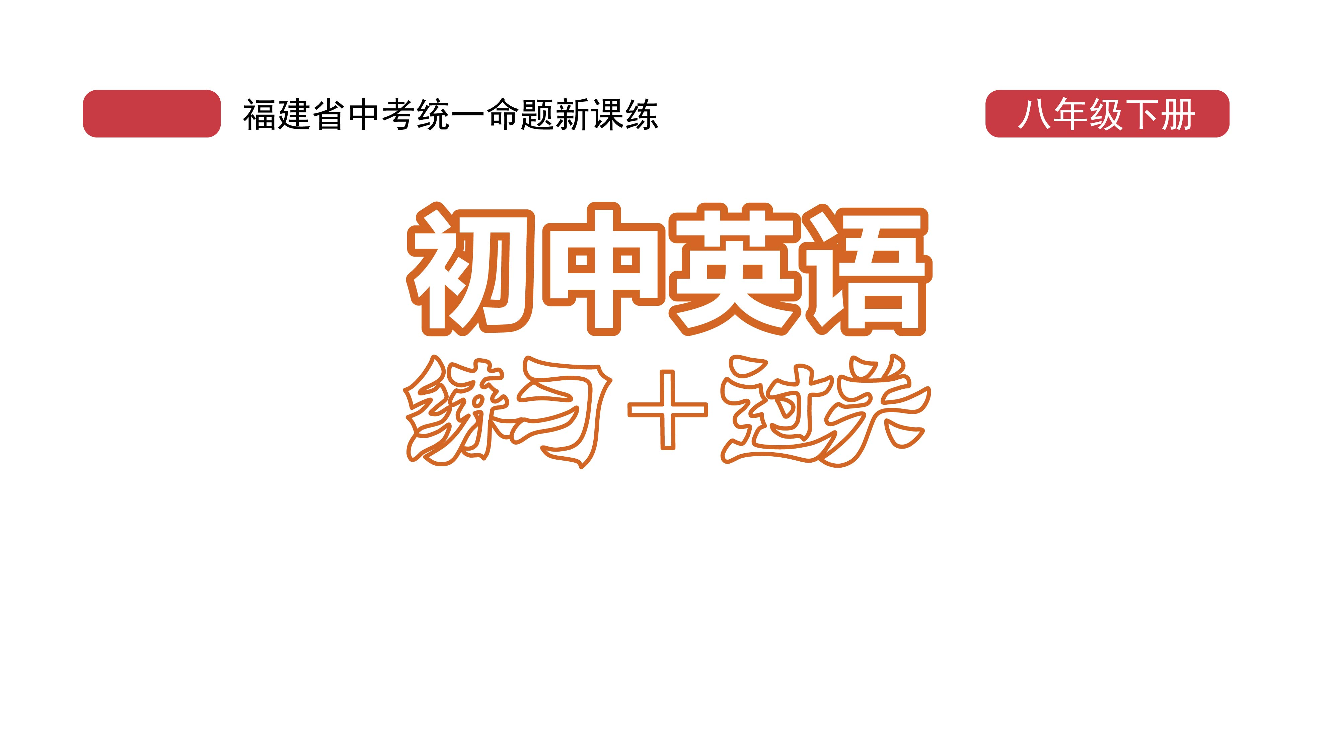
课时练习
模块六 第三章 第三节

Slide 2
一、翻译下列词组。
pay attention to
traffic signals
obey/follow the safety rules
in case of
1. 注意 _______________________
2. 交通信号 ___________________
3. 遵守安全规则 ________________________
4. 如果， 假使 ________________________

Slide 3
一、翻译下列词组。
5. 急救 _____________________
6. 打电话求助 _______________
7. 简言之，总之 _____________
8. 小心， 注意 ______________
first aid
call for help
in a word
look out

Slide 4
二、用括号内所给单词的适当形式填空， 每空一词。
1. News of the missing child’s ______ (safe) came as
a great relief(宽慰).
2. It’s dangerous to listen to music while ________ (cross) the road.
3. We should pay more attention to ____________ (prevent) norovirus(诺如病毒), especially in winter.
safety
crossing
preventing

Slide 5
二、用括号内所给单词的适当形式填空， 每空一词。
4. The first thing I _______ (notice) about the room was the smell.
5. To make way for the 14 elephants, the Yunnan government parked _______ (truck) alongside to stop possible interference(干扰).
noticed
trucks

Slide 6
三、情景交际。
1. 对方把车停在了错误的地方，你可以这样提醒他：
Do not _____________________________.
2. 路人向你问路，你想告诉他按路标提示走，可以
这样说：
You should _________________________.
park your car in the wrong place
follow the sign(s)

Slide 7
三、情景交际。
3. 你想告诉哥哥车速太快会导致事故，可以这样说：
___________________________________________
___________________________________________.
Driving/Riding too fast can cause accidents/
an accident

Slide 8

四、看图写话。
1. in case of
In case of a fire, call 119 for help.

Slide 9
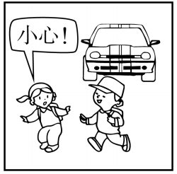
四、看图写话。
2. look, there
Look out, there is a car coming!

Slide 10
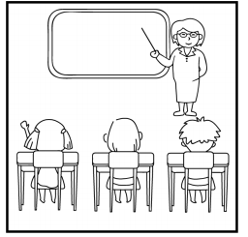
四、看图写话。
3. should, listen
Students should listen to the teacher carefully (in class).

Slide 11
五、熟词生义。
1. notice A. vt. & vi. 注意到；意识到
B. n. 布告； 通知 C. n. 察觉； 理会
_____ (1) I will put up a notice about the meeting.
_____ (2) The man shouted for help but they took no notice.
_____ (3) I noticed Tim was smiling at you just now.
B
C
A

Slide 12
五、熟词生义。
2. save A. vt. (拯)救 B. vt. 节约
C. vt. 储蓄；存储 D. vt. 留给（某人）
____ (1) Each of us must save every drop of water.
____ (2) Will you save me a seat on the bus?
____ (3) The girl saves some money for travel.
____ (4) Saving the earth begins with small things.
B
D
C
A

Slide 13


